Slide 1
UNIFIED EXPERIENCE PLATFORM (UXP)
December 2023

Slide 2
AGENDA
Our Goals
Deliverables
Data Ecosystems
Field Marketing Analysis
Now + Next

Slide 3











UNIFIED SYSTEMS & DATA
ACTIVATIONS
TRACE
FIELD MANAGEMENT
LOCATION & EVENT INTELLIGENCE
rTAG
PROJECT
SCOPES
TIME
FEES
RESOURCES
CONTENT
GENERATIVE AI
DAM
APPROVALS
COGNITIVE SERVICES (AI/ML)

Slide 4

TODAY
Momentum gathers meaningful post-event metrics by unifying data from different sources.
Information is either not available or not shared in a timely manner.
This limits Momentums spend and agility when generating insights.

Slide 5
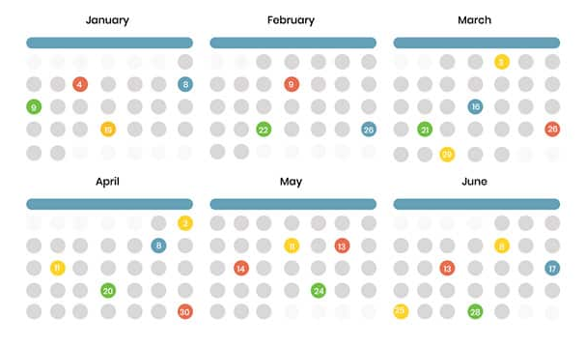









UNIFIED EXPERIENCE DATA ECOSYSTEM
Unified data aggregates data from disparate sources into a single view providing complete and accurate answers to critical questions.
Activation Schedule
Unified Experience Platform (UXP) and Input Procedure A front-end Input application and organization-wide process/system for collecting Activation Details and information: Activation Name, Activation Date, Activation Client, and Activation Location.
Unified Experience Data
Activation Insights
Field Management Portfolio-wide standardized system for managing event details, assets, and on-site wrap information. It includes a cloud/web-based tool accessible from anywhere for real-time updates and version control, eliminating the need for multiple spreadsheets.
Conversational Insights
Other systems: Walmart Hub, Splash, Placer data, Client owned systems
Cognitive Services

Slide 6
OUR GOALS / WHY UXP?

Slide 7
OBJECTIVES
Establish a unified data model
Generate a consistent Global Unique Identifier (GUID) for each activation
Create a method to capture all activations. Identifying owners, types, dates, and locations
Generate a master campaign Identifier (Parent ID) and an event date Identifier (Event ID)
Create the ability to integrate post-event metrics from other systems
Create the ability to integrate with event management systems used by Momentum

Slide 8
Unified experience platform – TOOLS & WORKFLOW
ACTION: Develop an application that can gather and unify data using the Microsoft Power Platform.
WHERE IS THE DATA?
To realize Momentum's ambition of becoming the "Nielsen of Experiences," it is essential to implement a unified data strategy and establish robust data governance. Creating a unified data model with both structured and unstructured data requires careful planning, organization, and analysis, to result in more valuable insights and a better understanding of complex data.

Slide 9
KEY DELIVERABLES
Unified Experience Platform (UXP) and Input Procedure A front-end Input application and organization-wide process/system for collecting Activation Details and information: Activation Name, Activation Date, Activation Client, and Activation Location.
Unified Experience Datawarehouse & APIs One location for all IDs and data generated from UXP. Data models and processes (ETL) to manage changes/updates within UXP Centralized data infrastructure that can be enriched with additional IDs and data from other 3rd party systems. Bidirectional APIs to communicate with 3rd party services to send and receive data.
Organization-wide BI/Analytics Dashboard (Experiential Intelligence Dashboard) An accessible and interactive web-hosted dashboard visualizing data from the data warehouse via KPIs and other metrics for Momentum and its clients.
Field Management System A single solution for all field staff to access event information details, training materials and record event recaps.
Activation Calendar Enable visibility into the Momentum activation calendar. Who, what, when and where.
Conversational Insights Leveraging AI to provide conversational insights based on aggregated data. It would provide Momentum with a user-friendly interface to access data and gain valuable insights, though conversion.

Slide 10
UNIFIED EXPERINCE BENEFITS
FEATURE | BENEFIT | PAIN SOLVED
Unified Experience Tracker (UET) | Centralized management of activation data | Scattered and disorganized data across multiple systems
Master campaign Identifier & event date Identifier | Unique identifiers for each campaign and each day of the event | Enabling the data team the ability to start work with greater agility
Unified Database | Consolidated data storage | Redundancy and inconsistency in data storage
Activation Calendar | Easy visualization of scheduled events | Inefficient event planning and tracking
Client Power BI Dashboards | Customizable data visualization for clients | Limited client access to data and insights
Field System | Single system for all field related data to live. Who worked the events, what materials do they need for training, and what happened during activations. | Inconsistent and disorganized data being recorded per event from field teams.
API Integration | Seamless communication with field management systems Real-time data updates across UET and field management systems | Manual data transfer and synchronization Inconsistent data between systems

Slide 11
FIELD MARKETING PLATFORM ANALYSIS

Slide 12
GOAL
Identify a field management cloud platform that can manage event details, assets, and training material and collect post-event wrap information.

Slide 13
KEY REQUIREMENTS
FEATURE | DESCRIPTION
Dashboard View | A wrap up view for BL to see all scheduled, in progress, or recapped events.
Calendar | A view of all ongoing or recapped events.
Bi-Directional API | Ability to ingest GUID (and any updates to name, location, program etc) as well as POST data to Momentum BI.
Mobile optimized for field staff | Mobile phone friendly (native app or web app) for field staff to record data from their phones.
Attachments for Event | Momentum to upload training documents, troubleshooting guides, directions to site location, etc—easily accessible for field staff.
Offline Data Entry | Option to push data to live if network connection is unstable.
Media Upload and Tagging | Video and photo upload—Momentum can tag photos/rate photos to easily use for client reports.
SMS Event Reminders | Push notifications for field staff to work or recap events.
Recap Notifications | Reminders to recap events (field staff).
Review Recap Reports prior to submitting | Recap data will not push to Momo BI unless "approved" by Momentum staff.

Slide 14
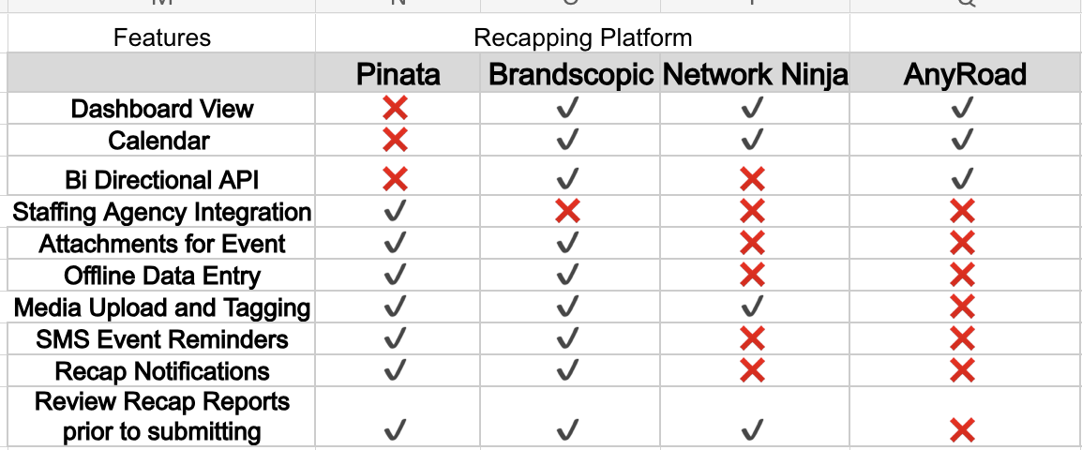
FIELD MARKETING FEATURES
Top 3 Platforms + AnyRoad that meet the requirements of both Verizon and overall Momentum needs.

Slide 15
FIELD MARKETING - COMPARISON
 | Pinata | Brandscopic | Network Ninja | AnyRoad
STRENGTHS
Definition | Easy to use, attractive platform with the ability to onboard and integrate with staffing agencies for robust field marketing recaps | Simple, no frills UI, gathers field marketing recaps from teams and organizes the data into one platform that will easily transfer data to MOMO BI | Field marketing recapping, asset management system. Has many custom features that require custom builds and money to create and test. | Primarily supports ticketed events and shows the consumer journey once a ticket to an event is purchased. Can support QR code creation, registrations and surveying but does not allow for field marketing recaps and users within the system.
Superior Qualities | Attractive UI | Very Simple | Robust Scheduling | Ticketed event support
Core Competencies | Staffing Agency Integration | Bi-Directional API | Emailed custom reports | Post event sales
Technological Advancement | Offline Data Capture | Offline Data Capture | Custom Report builder | Ticket purchasing
WEAKNESSES
Incompetencies | No API | Basic Interface | Difficult to Navigate | No qualitive data
Areas of Improvement | No dashboard | Overall UI | Learning Curve | Add field staff users and dashboard
Obstacles | Most Expensive | Small Support Team | Load Lag | No field marketing users/recaps

Slide 16
COST COMPARISON
Brandscopic: Unlimited users for all admin, client, or field staff user seats
Brandscopic: Cap at 3k event hours per month: equivalent of 300 events per month. each 10 hours long
Pinata: $49 / user; no volume discounts
Network Ninja: the most cost-effective but will come with the least features
 | Brandscopic | Pinata | Network Ninja
/year | $12,000 /year | $30,398/year | $12,000 / year, unlimited tasks and events
/month | $1,000.00 | $1,666.00 | $1,000.00
details | Event Hours per month: 3k | 100 tasks per month | unlimited users and events
users | Unlimited users | 40 users / $49/ USER | Unlimited

Slide 17
NEXT STEPS
Technology
Develop an Activations Application
Design the Experiential Atomic Data Model architecture
Deploy Brand Brandscopic for Verizon
What we asked of Bethany
Audit of each client account, what each account is measuring and in what format.
Analysis of why event information is hard to obtain and keep accurate.
Plan course correction and identification of information owners.

Slide 18
NEXT STEPS
Momentum Data Discovery
Audit all data capture but the client team
What do we have?
What is the source?
What is the cadence?
What is captured manually by a field team?
Technical Discovery UED
Detailed requirements document
High-level solution architecture
API definitions
DB design
Front-end Mockup
Field Management: BrandScopic
Vendor Set Up, security & sign SOW
Design a deployment plan
Process and training material
Load test use case
Placer POC
Data extraction
API design calculating the number of calls
Document insights gathered

Slide 19
THANK YOU

Slide 20
APPENDIX

Slide 21
NEAR TERM VS LONG TERM FIELD MARKETING

Slide 22
VERIZON X MOMO ORGANIZATIONAL DATA SYSTEM​
Verizon Experiential Intelligence Dashboard:
Measurement of all Verizon experiences
Automated processes and data ingestion
Real-time Dashboard/Data accessible by non-analytic business users
Portfolio-wide system:
Booking and planning “events.”
Managing Event Details, Changes, Updates, and Assets/Items required for events
Collecting on-site information through a cloud platform/web-based tool
Updatable by anyone with access from anywhere with built-in version control
Mitigate: 10 different data sources with the same and possibly conflicting manually collected information

Slide 23
UNIFIED DATA + FIELD MANAGEMENT What we need to get there (Components)
Momentum owned and developed Cloud Database for storage and sandbox (VZDB1 Azure DB)
Direct Data Pipeline development with ALL VZ Experiential Datasources:
Master Calendar/Schedule of Events and Event Details
Common Backend
QR Tiger
Qualtrics (Survey)
Verizon Adobe Analytics Files
BA/BL/FM Collected manual on-site information
SOP/System of Processes and cadence for Data Governance, Auditing, and regular maintenance and QA
Schedule for datasource updates
Event Management Platform/Front End Tool for collecting manual information
Accessible via mobile
Momentum controlled users and permissions
Customizable fields encompassing all events
Built in reminders and schedule for missing fields/recaps for past events
Calendar view
API data pipeline

Slide 24
LOOKING AHEAD

Slide 25
LOOKING AHEAD: Beyond Unified Data Model
PHASE 1 Unified Event Data | PHASE 2 Product | PHASE 3 Commercial Pricing
Continued ingestion of both our current client and MOMO proprietary event data Standardized ingestion models API, 3rd party data sources, tagging/flagging Storage Cognitive Services / queries | Ingest new client data – use of standard method as well as data transformation required Compare client data to our event data by category – outside/inside, sports, music etc. , timing, weather Generate reports – trends, benchmark comparisons, “We Know” series etc. Dashboards of client data with some benchmarks/comparison flags by category | Ingestion Pricing – one time & ongoing, use of API Category inclusion Pricing for comparison (do some cost more?) Custom report Pricing for deeper dives into your data and the comparison to our data set Dashboard creation/access Pricing with licensing/seat access

Slide 26
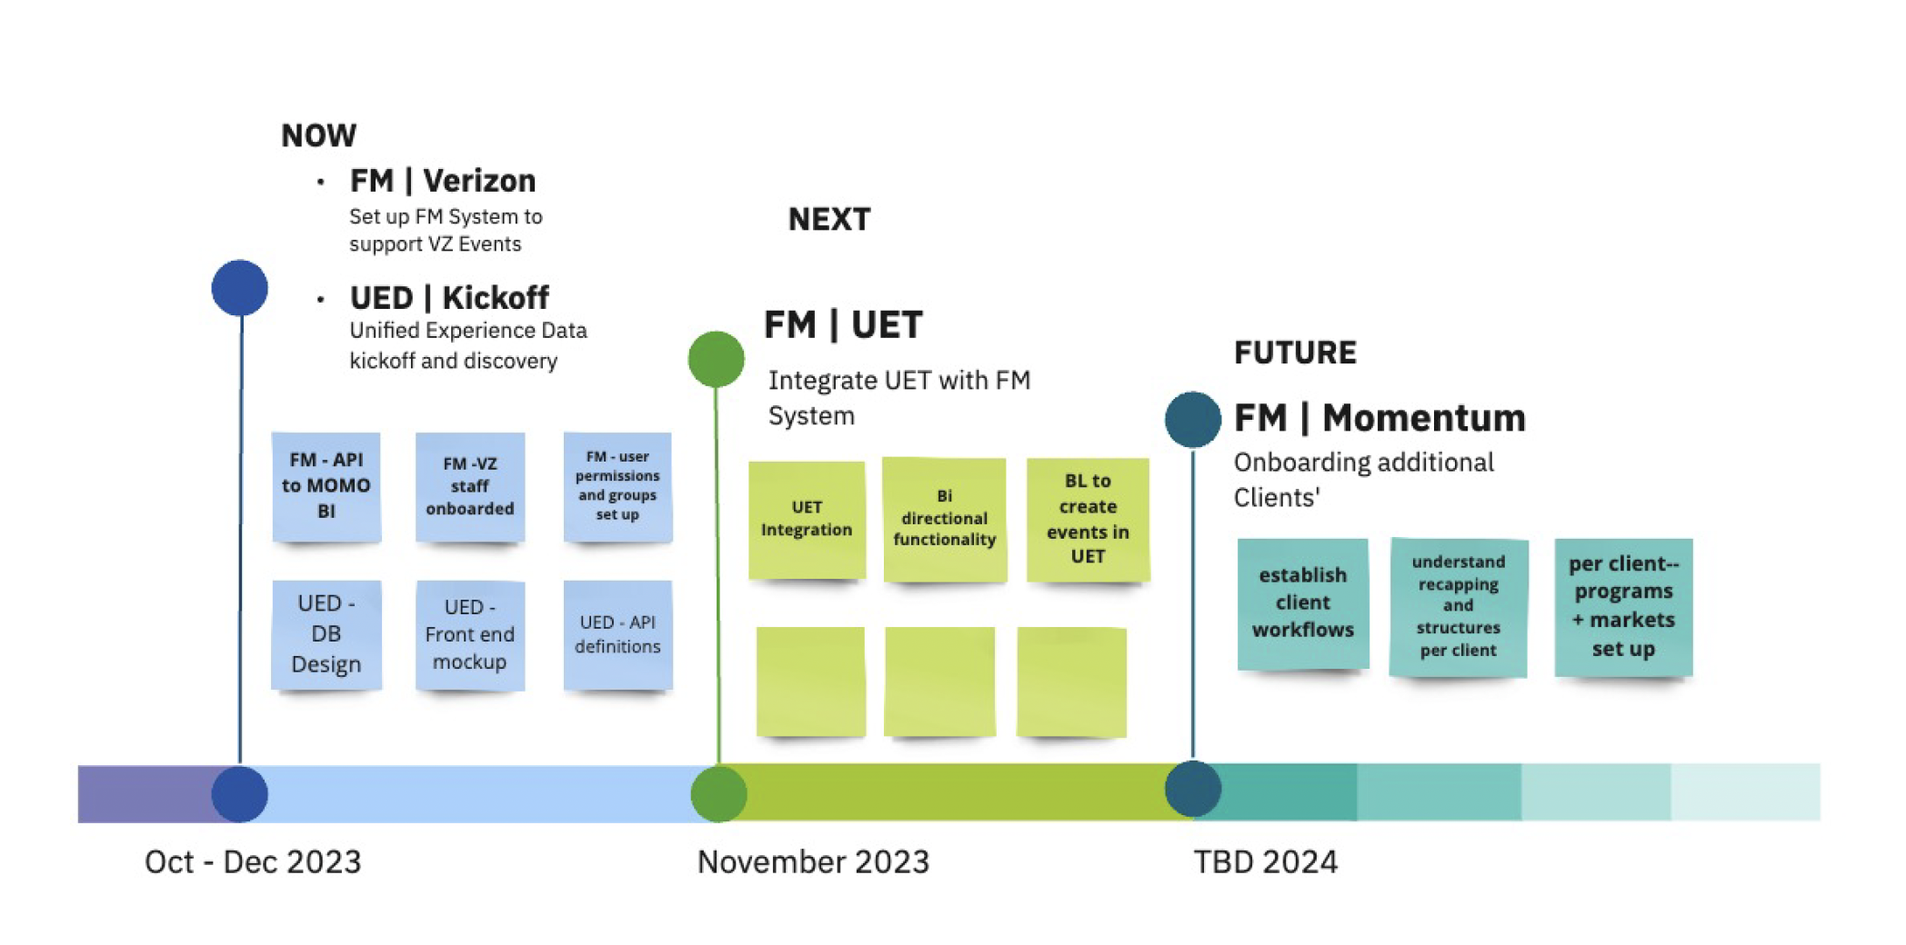
NOW + NEXT

Slide 27
POWER PLATFORM PROOF OF CONCEPT

Slide 28
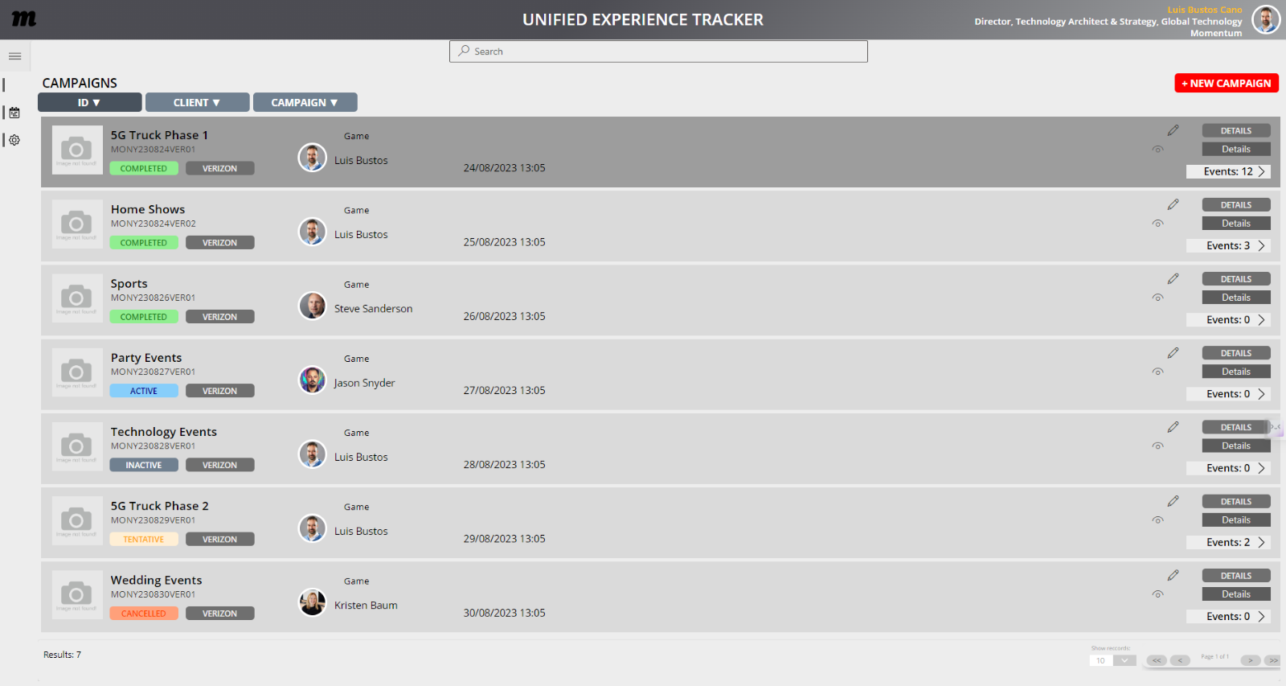
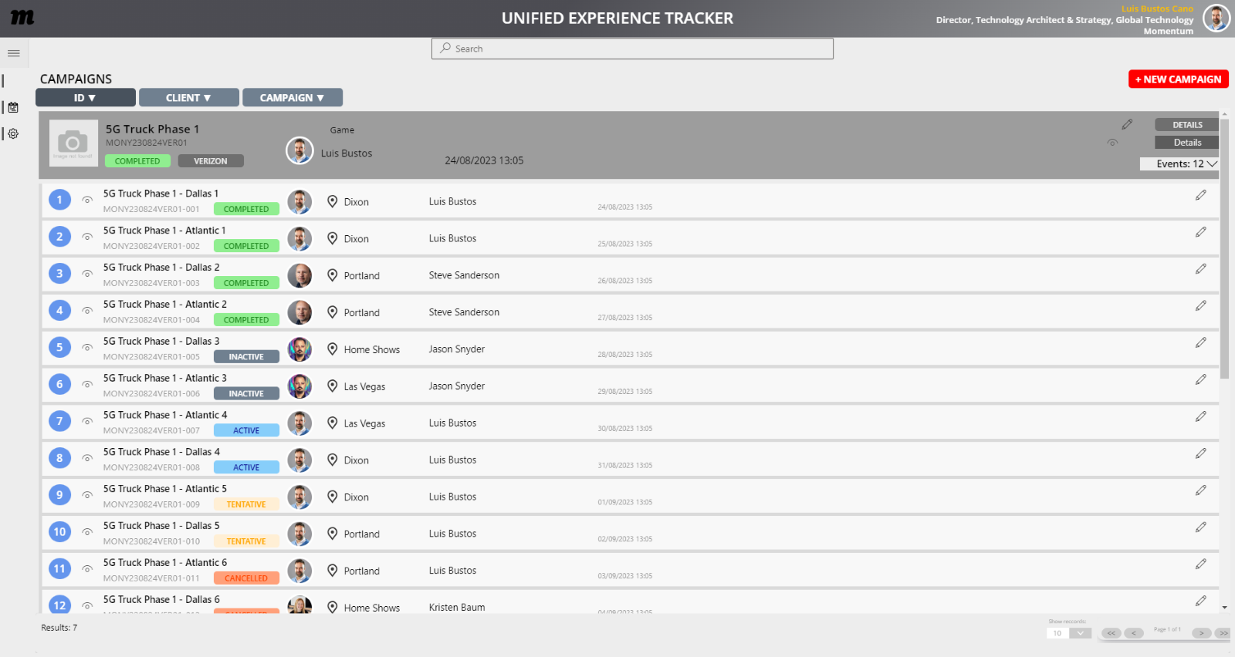
CAMPAIGNS & EVENTS
Create, edit, delete Events
Display Event data
Create an intelligible campaign ID
Sorting search returns based on criteria: ID, Name, Status, etc
Pagination
Retrieve AD data for event originator/assignee
Display map data and standardized address

Slide 29
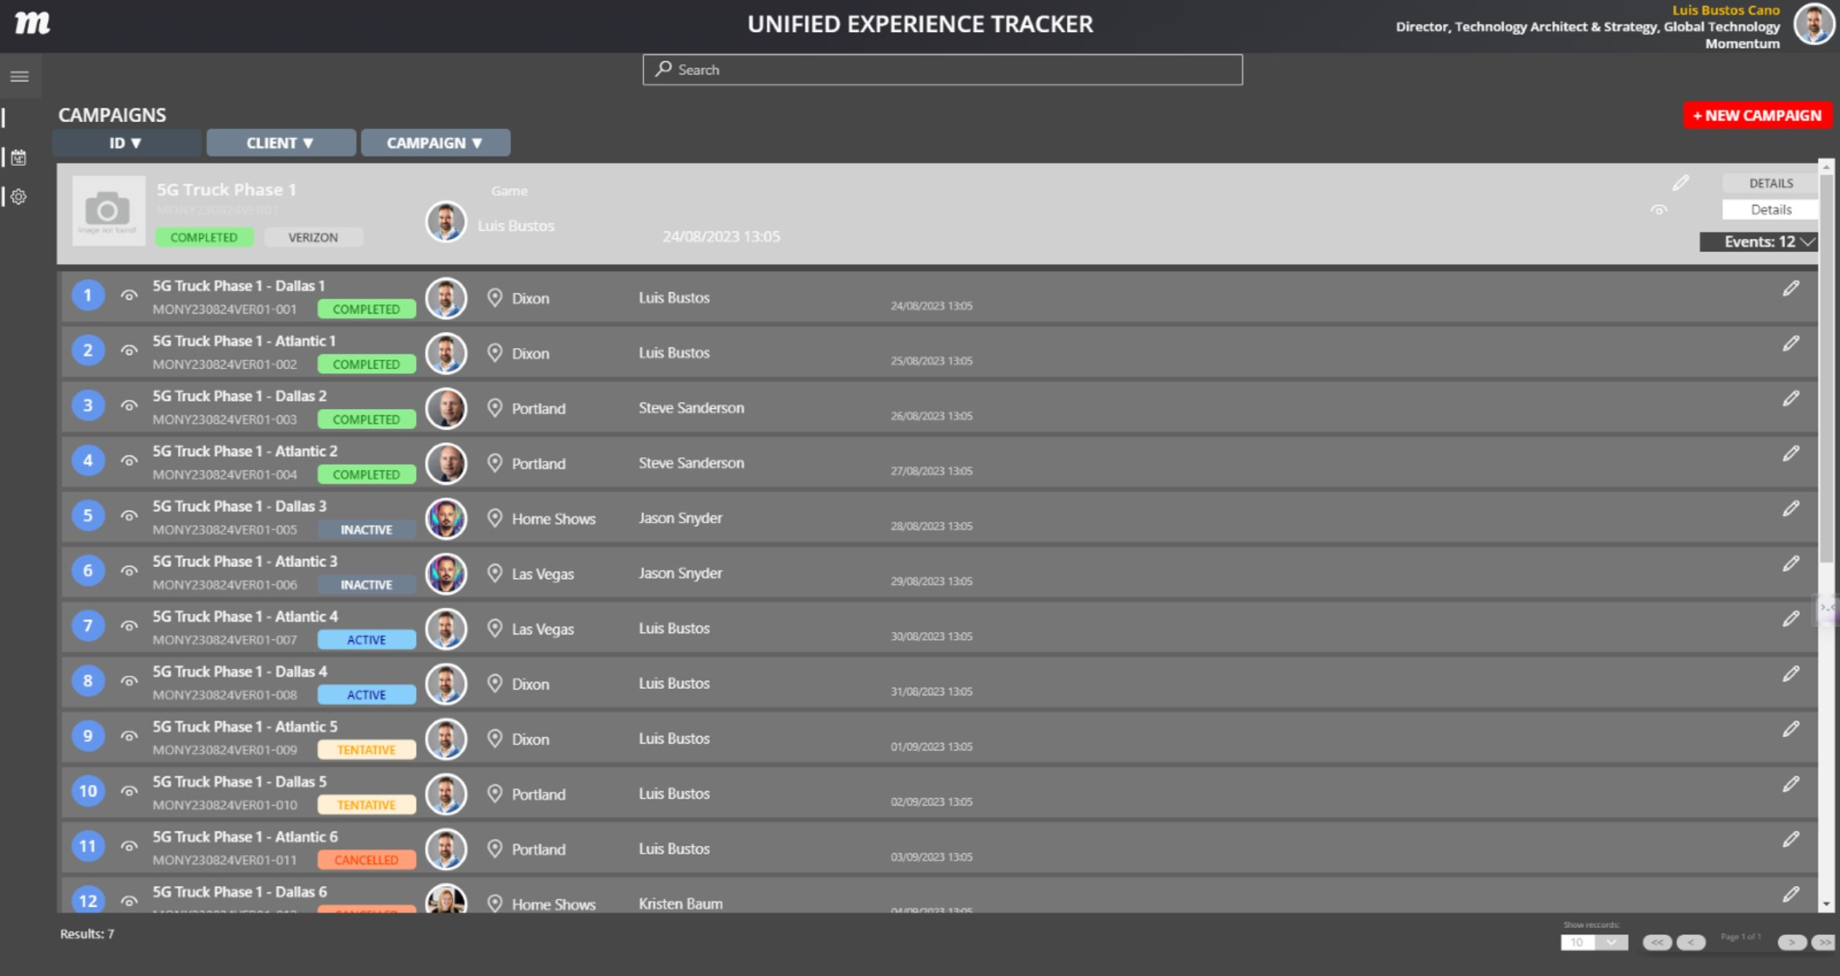
CAMPAIGNS & EVENTS
TURES
Theme variations stored at user-level permissions
This can include read/write permissions or view only permissions
Configurable by:
Client
User
Team

Slide 30
POC - THEMES

Slide 31

USER PERSONA
PERSONA:
GOALS:
Name of Persona: Business Leaders & Project Managers Role: Familiar with account teams and account event scheduling, communicates with Clients' to understand number of events, event details, scope and timing for execution
A process to keep all campaigns & events up to date.
One source of truth for all event scheduling
Mitigate multiple spreadsheets and Smartsheets where events are tracked
Review upcoming and past events for planning
DESCRIPTION:
CHALLENGES:
My job is to oversee and drive the successful execution and delivery of projects within the agency, through building and orchestrating project plans across the business.
As a Business Leader or Project manager, I would like to have one location to track events for my client campaigns.
View upcoming, past, and scheduled events in a list and a calendar. I sometimes am required to provide Client with lists of events per region or team
All of my events require a unique QR code, I would like to tie each event with a QR code in an easier way to control and test.
Any event that requires BA recaps should talk to our field marketing platform to capture event metrics
Once executed, all final data should be sent to MOMO Bi
Siloed communication: change requests between client and production teams
Large volumes & multiple locations to track the same information
Multiple stakeholders in projects
WORKFLOW & FEATURES USED:
Scheduling event data: Event Name, Date, Location, Team
Assigning events to Field Marketing system
QR Code generation within UXP
Calendar and Event list within UXP

Slide 32
OUR GOALS / WHY UXP?
VISION
BUSINESS STRATEGY
STEPS
WHAT
WHY
HOW
Momentum will implement a unified data solution that integrates data from disparate sources into a single view, providing accurate answers to critical questions.
A standardized and repeatable process is required for scheduling and recording activation data.
Create a application that will be to source of the through for all activations within momentum.
Create a database that creates and stores all GUIDS and UIDs for both Campaigns and Events.
UXP technology will:
Streamline data collection.
Provide a centralized location.
Create a standard method when joining to 3rd Party
Data process discovery
Developing an application that can gather and unify data, allowing users to edit all data
Bi-directional API: Send & and receive event Information to any required system to create an event and receive back IDs so that bidirectional updates can be performed from either system.
Data governance: create a method to ensure data quality and completeness.
Training: All teams on how to enter events into the new application
PRODUCT
AIM
EXECUTE

Slide 33
BENEFITS
Our primary audience is business leaders and project managers who are in charge of activations.
​DELIVERABLE | ​BENEFIT ​ | PAIN SOLVED ​
​Front End | ​Centralized management of all activation data ​ | Scattered and disorganized data across multiple systems ​
Database | ​All GUIDs, and base Information. Can be enriched with additional IDs and transactional data from 3rd party systems | ​Difficulty in tracking and managing events ​and multiple systems Manual GUID creation
APIs | Will connect bi-directional API's with third party systems | Manual downloads of data and manual data mapping
Training & Documentation | Streamline training and documentation across business units | Lack of unified training across teams and offices

